Slide 2
Name of Students
Roll No. | Name of Student
1 | Ansari Yunus
2 | Babriya Ajay
3 | Baldaniya Kamlesh
4 | Bharad Ghanshyam
5 | Bhut Darshan
6 | Bhuva Krishna
7 | Bodar Hiren
8 | Chotaliya Swati
9 | Dangar Raj
10 | Katheliya Dhaval

Slide 3
TWO STROKE I.C. ENGINE

Slide 4
I.C. engine:-
The combustion is taking place inside cylinder is known as I.C. engine
I.C. engine classification:-
1)Four stroke engine.
2)Two stroke engine.

Slide 5
TWO STROKE I.C. ENGINE:-
The working cycle complete in two stroke is known as two stroke I.C. engine
TWO STROKE classification:-
1)Petrol engine.
2)Diesel engine.

Slide 6
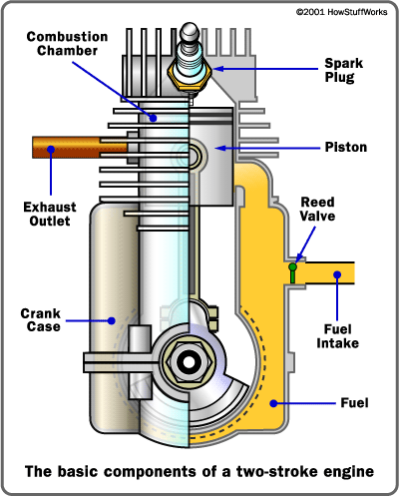
TWO STROKE I.C. ENGINE

Slide 7
Working of Two Stroke engine:-
The working of two stroke engine includes following types of strokes.
! Suction stroke.
! Compression stroke.
! Power/ Expansion stroke.
! Exhaust stroke.

Slide 8
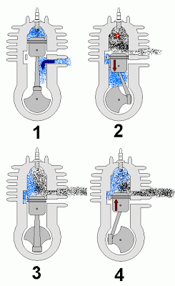
Working of Two stroke engine.

Slide 9
1) Suction Stroke:-
In this stroke fuel is enter in the cylinder by Inlet port.
2) Compression stroke:-
In this stroke fuel is compressed by piston & crank shaft arrangement.
3) Power/ Expansion stroke:-
In this stroke fuel is injected by spark plug or fuel injector and give the work so, this stroke known as power stroke.
4) Exhaust stroke:-
in this stroke the exhaust stroke coming out throw exhaust port.

Slide 11
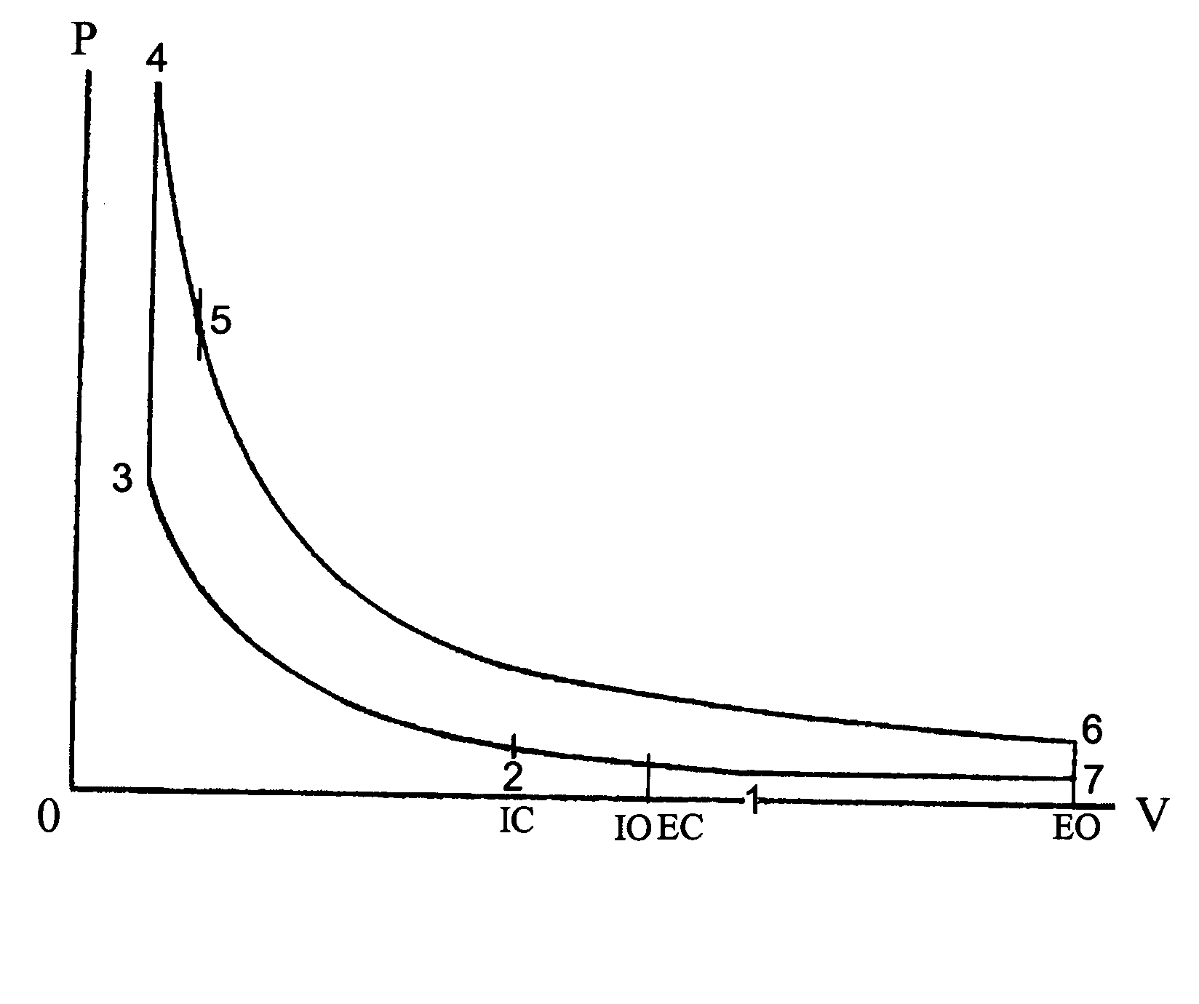
Two stroke Engine P-v Diagram

Slide 12
ADVANTAGES OF TWO STROKE ENGINE:-
It has no valves or camshaft mechanism, hence simplifying its mechanism and construction.
For one complete revolution of the crankshaft, the engine executes one cycle- the 4-stroke executes 1 cycle per 2 crank shaft revolution.
Less weight and easier to manufacture.
High power to weight ratio.

Slide 13
Dis-advantages of Two stroke engine:-
1)The lack of lubrication system that protects the engine parts from wear. Accordingly, the 2-stroke engines have shorter life.
2) They do not consume fuel efficiently.
3) They produce lots of pollution.
4) Sometimes part of the fuel leaks to the exhaust with the exhaust gases.

Slide 14
APPLICATION OF TWO STROKE ENGINE:-
Motor cycles
Mopeds
Underbones
Scooters
Tuk-tuts
Snowmobiles
Karts
Ultralights
Model airplanes

Slide 15
Thank You
GUIDE BY:-
Prof. ANKIT V SATA

